Slide 1
Docker training
p.pires@travelaudience.com

Slide 2
Before we begin
Docker 17.06 (any Linux distro with kernel 4.0+ or macOS 10.11+).
Git 2.14
$ docker pull debian:8
$ docker pull jenkins/jenkins:lts-alpine
$ docker pull alpine:3.6
$ docker pull ubuntu:16.04
$ docker pull mariadb:10.2.8
$ docker pull redis:4
$ docker pull openjdk:8u141
$ docker pull quay.io/pires/docker-jre:8u131_r2

Slide 3
Agenda
What is Docker
What is a container?
Why use containers?
What is a container image?
Docker platform overview
Docker commands reference
Building container images
Distributing container images
Questions?
Addendum

Slide 4
What is Docker?

Slide 5
What is Docker?
Docker is a platform for building, shipping and running applications in a loosely isolated environment called a container.
Docker supports Linux and Windows containers. We’ll focus on the former.

Slide 6
What is a container?

Slide 7
What is a container?
A container is a package that contains binaries and their dependencies.
A container is lightweight because it doesn’t need the extra load of a hypervisor, but runs directly within the host machine’s kernel. This means you can run multiple containers on the same machine, physical or VM, each running as an isolated process in user space.
Also, a container takes up less space than a VM (container images are typically tens of MBs in size), and start almost instantly.
Let’s look at a picture!

Slide 8
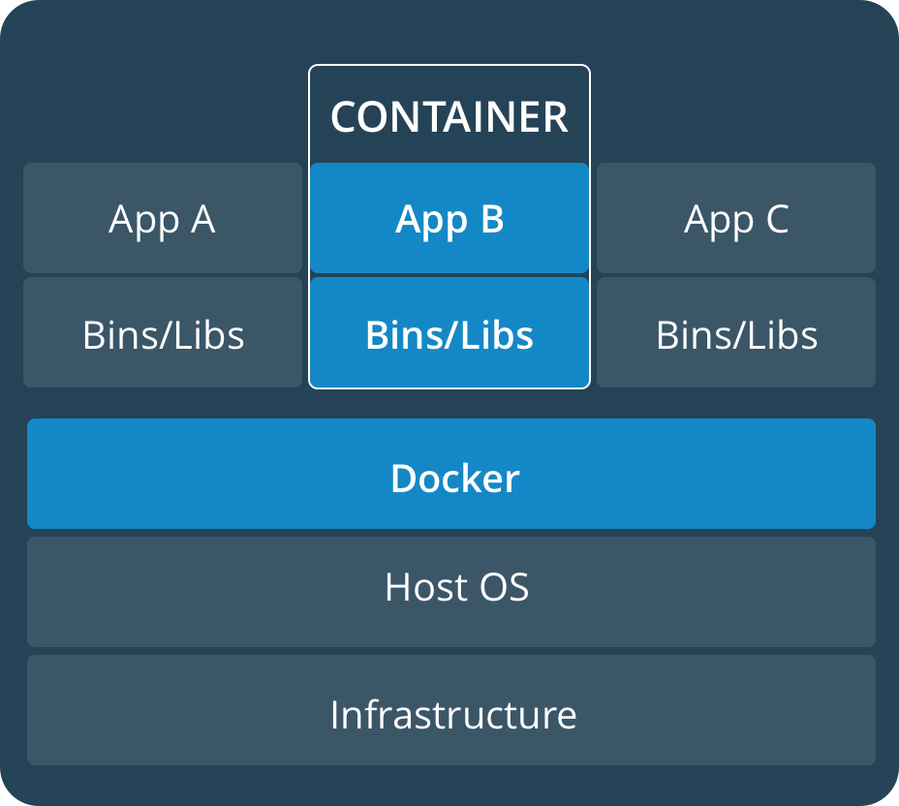
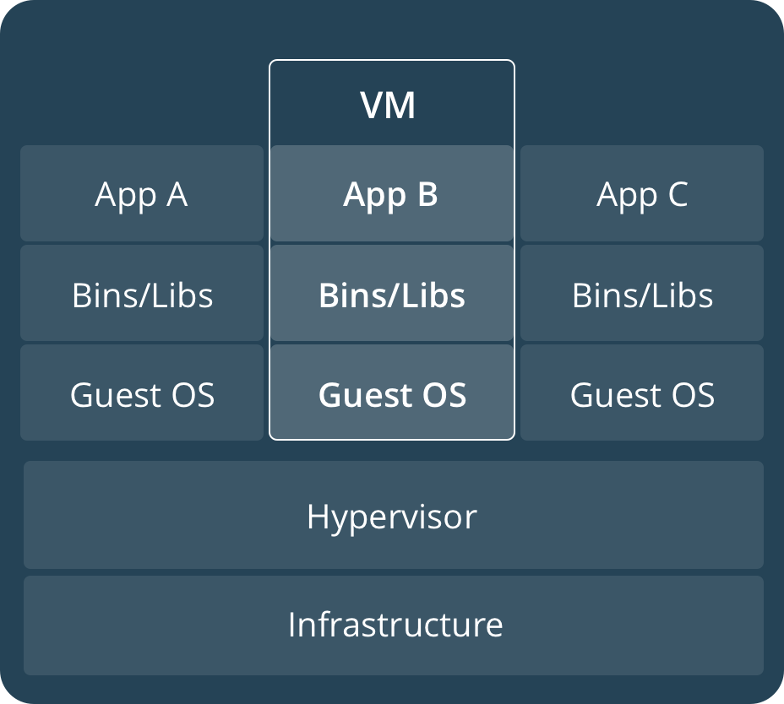
What is a container?

Slide 9
What is a container?
A Linux container's root filesystem is usually based on stripped-down versions of generic Linux distributions such as Debian or Ubuntu, or on specialized ones such as Alpine.
Again, a Linux container does not include a Linux kernel — it uses the host's kernel and as such is usually small on size, fast to launch and light on resources.

Slide 10
Why use containers?

Slide 11
Why use containers?
A container can run unchanged on different machines with different configurations, and always exposes the same execution environment to the application.
Containers help mitigate the "works-on-my-machine" effect and ease the transition between different environments, such as development, staging and production.
Also, and once more, a container takes up less resources than a VM which makes it leaner and faster to run and manage.

Slide 12
What is a container image?

Slide 13
What is a container image?
A container image is a template from which containers are launched. Usually, they belong to a repository and have an associated tag (e.g., containers.travelaudience.com/my-app:1.0), where:
containers.travelaudience.com is the repository
my-app is the image name
1.0 is the tagged version
Internally, an image is composed of an ordered collection of layers — a set of sequential changes made to the container, i.e. each instruction in the container image descriptor.

Slide 14
Docker platform overview

Slide 15
Docker: containerd + dockerd + docker
Docker is a complex platform consisting of several moving parts. However, and for the most part, it can be thought of as the union of three main components:
containerd: a container runtime which provides APIs for container execution and supervision, image transfer and storage, storage and networking.
dockerd: a daemon that runs on the host, embedding containerd and interacting with it to manage containers, images, security, volumes and etc...
docker: a command-line tool which acts as a client to dockerd.
Notes:
Some other interesting points may be:
containerd acts as an interface to the kernel’s cgroup, namespace and SELinux features.
dockerd does the actual job of building a Dockerfile (although we only talk about that later on).
docker is responsible for sending local context to dockerd — like, for example, the build context when building a Dockerfile.

Slide 16
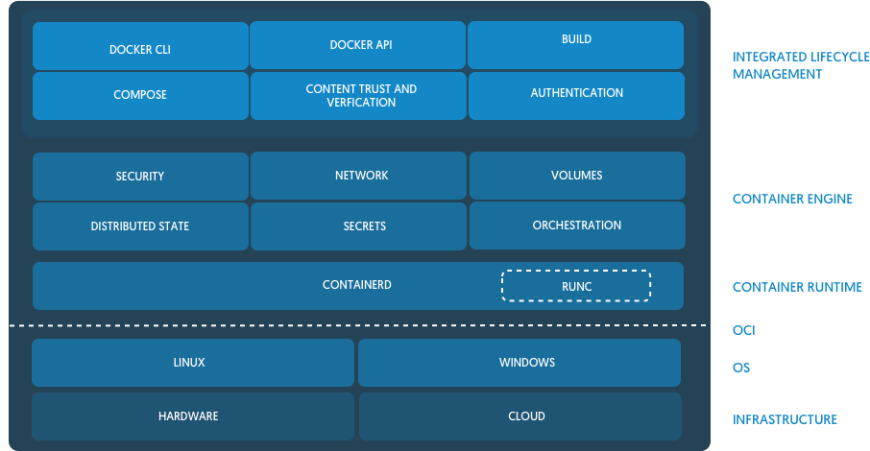
Docker: containerd + dockerd + docker

Slide 17
Docker: containerd + dockerd
# dockerd
INFO[0000] libcontainerd: new containerd process, pid: 5596
WARN[0000] containerd: low RLIMIT_NOFILE changing to max current=1024 max=1048576
INFO[0001] [graphdriver] using prior storage driver: aufs
INFO[0001] Graph migration to content-addressability took 0.00 seconds
WARN[0001] Your kernel does not support swap memory limit
WARN[0001] Your kernel does not support cgroup rt period
WARN[0001] Your kernel does not support cgroup rt runtime
INFO[0001] Loading containers: start.
INFO[0001] Default bridge (docker0) is assigned with an IP address 172.17.0.0/16. Daemon option --bip can be used to set a preferred IP address
INFO[0001] Loading containers: done.
INFO[0001] Daemon has completed initialization
INFO[0001] Docker daemon commit=874a737 graphdriver=aufs version=17.06.1-ce
INFO[0001] API listen on /var/run/docker.sock

Slide 18
docker commands reference

Slide 19
docker
docker provides several commands for managing containers and images. These are the most common ones:
Containers |  | Images
run | start | images
logs | exec | pull
restart | ps | rmi
stop | rm | build

Slide 20
docker run
docker run executes a command in a container created from the specified image:
$ docker run debian:8 ping -c 1 google.com
PING google.com (216.58.201.142): 56 data bytes
64 bytes from 216.58.201.142: icmp_seq=0 ttl=37 time=0.246 ms
--- google.com ping statistics ---
1 packets transmitted, 1 packets received, 0% packet loss
round-trip min/avg/max/stddev = 0.246/0.246/0.246/0.000 ms

Slide 21
docker run
docker run allows for port mappings to be established between the host and the container:
$ docker run --rm -p 9090:8080 jenkins/jenkins:lts-alpine
Opening your browser and pointing to http://127.0.0.1:9090 will show Jenkins configuration screen, meaning that the instance of Jenkins that is running inside the container is now exposed and reachable at port 9090 in our host machine.

Slide 22
docker run
docker run allows for environment variables to be set :
$ docker run --rm -e MY_SECRET=your_secret alpine:3.6 sh -c 'echo $MY_SECRET'

Slide 23
docker run
docker run allows us to interactively run commands inside a container:
$ docker run --rm -i -t ubuntu:16.04 /bin/bash
root@7d3697a74b77:/# date
Fri Aug 25 08:24:05 UTC 2017
root@7d3697a74b77:/# exit
exit

Slide 24
docker run
Ultimately, we’ll want to have our containers running in background (detached) and to give them a name:
$ docker run \
-d \
--name mariadb \
-e MYSQL_RANDOM_ROOT_PASSWORD=yes -p 3306:3306 mariadb:10.2.8
135e27c525f44b33ca4e6e75c803513a4e08cd96e3917b44a0042a129e05cb57
This will output the container ID for the newly created container and exit. The container will be running in background until stopped or removed.

Slide 25
docker logs
The previous command will start a MariaDB container in detached mode and dump a random password to the logs. But how can we see the logs?
$ docker logs mariadb
(...)
GENERATED ROOT PASSWORD: Eet8oingoopheizeijaejia5vieBoo5A
(...)
To see the logs in "real-time", append the --follow flag to docker logs:
$ docker logs --follow mariadb

Slide 26
docker container lifecycle
Docker allows for managing the lifecycle of an existing, but not exactly running, container by using docker start, docker stop and docker restart:
$ docker start mariadb
mariadb
$ docker stop mariadb
mariadb
Try and stop the running container. Now start it again. Now restart it.

Slide 27
docker exec
Once we have a running container we may have the need to execute a command or enter a shell inside the container for debugging or maintenance purposes.
docker exec combined with the -i and -t parameters can be used to place us on an interactive shell inside a given container:
$ docker exec -i -t mariadb /bin/bash
root@135e27c525f4:/#
To exit the interactive shell, type Ctrl+C or exit.

Slide 28
docker ps
At some point we’ll need to list all the containers we have created. To list running containers, we can use docker ps:
$ docker ps CONTAINER ID IMAGE COMMAND CREATED STATUS PORTS NAMES 135e27c525f4 mariadb:10.2.8 "docker-entrypo..." 22 minutes ago Up 10 minutes 0.0.0.0:3306->3306/tcp mariadb
To list all containers, including stopped ones, we can use docker ps -a:
$ docker ps -a CONTAINER ID IMAGE COMMAND CREATED STATUS PORTS NAMES 135e27c525f4 mariadb:10.2.8 "docker-entrypo..." 22 minutes ago Up 10 minutes 0.0.0.0:3306->3306/tcp mariadb 218c20b0d62f debian:8 "ping -c 1 goog..." 25 minutes ago Created opti...

Slide 29
docker rm
To remove a container we must first stop and then use docker rm:
$ docker stop mariadb
mariadb
$ docker rm mariadb
mariadb
This is a destructive action, so we need to make sure we really intend to delete the container.
Let’s go ahead and remove any old containers we may have around!

Slide 30
docker images
docker images lists all available images:
$ docker images
REPOSITORY TAG IMAGE ID CREATED SIZE
jenkins/jenkins lts-alpine b9ba57a3bcca 35 hours ago 223MB
mariadb 10.2.8 58730544b81b 4 days ago 397MB
ubuntu 16.04 ccc7a11d65b1 2 weeks ago 120MB
debian 8 86baf4e8cde9 4 weeks ago 123MB

Slide 31
docker pull
docker pull downloads an image from a remote registry:
$ docker pull redis:4
4: Pulling from library/redis 5233d9aed181: Already exists ca1b33d3f114: Already exists 920cdc17d3c2: Already exists 6f939f708ee9: Downloading [===> ] 5.324MB/8.063MB 4ba0e186289d: Download complete 1e448b71a4f0: Download complete
The default remote registry for Docker images is Docker Hub.

Slide 32
docker rmi
docker rmi removes an existing image:
$ docker rmi redis:4 Untagged: redis:4 Untagged: redis@sha256:a777689(...) Deleted: sha256:d4f2594(...) Deleted: sha256:072e0b0(...) Deleted: sha256:3bc8389(...) Deleted: sha256:c1dbc0d(...)

Slide 33
Building container images

Slide 34
Dockerfile
Images are created from an already existing container or by creating and building a Dockerfile.
A Dockerfile is a set of instructions that describes how to provision, install and run an application.

Slide 35
Dockerfile
A build occurs within a given build context — by default, the contents of the directory containing the Dockerfile — and cannot reference anything outside that context.
It is important to note that each instruction in a Dockerfile changes either the filesystem or the execution parameters, thus adding a new layer to the image.

Slide 36
Dockerfile
$ cat ./Dockerfile
FROM ubuntu:16.04
RUN apt-get update
RUN apt-get install --yes openjdk-8-jre
COPY hello-world.jar /
CMD ["java", "-jar", "/hello-world.jar"]
$ docker build --tag hello-world:1.0 .
Sending build context to Docker daemon 583.7kB
(...)
Successfully built 20c2c51f7a8c
Successfully tagged hello-world:1.0

Slide 37
Dockerfile » Exercise
We will be building a Dockerfile for tcp-echo-server at the same time we introduce the most important Dockerfile instructions. There are a few things that we must know about tcp-echo-server in order to build a proper Dockerfile:
It is written in Java 8 — needs JDK8 to build, JRE8 to run.
It is built using Gradle and the resulting JAR is standalone (über-jar).
The resulting JAR will be written to ./build/libs/tcp-echo-server.jar.
tcp-echo-server does not access or persist any data on disk.
It accepts three environment variables as config — DEBUG, HOST and PORT.
By default DEBUG=false, HOST=0.0.0.0 and PORT=7.

Slide 38
Dockerfile » Exercise
Let’s start by cloning the Git repository for tcp-echo-server and creating an empty file named Dockerfile at the repository’s root:
$ git clone https://github.com/travelaudience/training-docker.git
$ cd training-docker
$ git checkout 0.1
$ touch Dockerfile
Now let’s open this new Dockerfile file with our favorite editor and follow along.

Slide 39
Dockerfile » FROM
The FROM instruction is usually the very first in any Dockerfile, and sets the base image for the next steps.
FROM <image>:<tag>
This can be seen as choosing a base root filesystem for our containers.

Slide 40
Dockerfile » FROM » Exercise
As tcp-echo-server is written in Java, and since we will compile it as we build the Dockerfile, we will choose one of Java’s official Docker images as our basis:
FROM openjdk:8u141
This image provides us with JDK8u141, which we will use to build the project.

Slide 41
Dockerfile » ENV
The ENV instruction takes a key and a value and exposes them as an environment variable.
ENV <key> <value>
These variables are made available to the application and to other instructions in the Dockerfile.

Slide 42
Dockerfile » ENV » Exercise
We will declare some environment variables that we will use in other Dockerfile instructions…
ENV SOURCE_PATH /src/
... as well as the environment variables that tcp-echo-server accepts as config:
ENV DEBUG false ENV HOST 0.0.0.0 ENV PORT 7
These can later be changed when launching containers.

Slide 43
Dockerfile » WORKDIR
The WORKDIR instruction sets the current working directory inside the image's filesystem.
WORKDIR <path>
The target directory will be created if necessary. WORKDIR is the correct way to change directories inside a Dockerfile.

Slide 44
Dockerfile » WORKDIR
FROM ubuntu:16.04
RUN cd /tmp
RUN pwd
Will output / while building.
FROM ubuntu:16.04
WORKDIR /tmp
RUN pwd
Will output /tmp while building.

Slide 45
Dockerfile » WORKDIR » Exercise
Let’s switch to the directory to where we will copy the tcp-echo-server source code:
WORKDIR $SOURCE_PATH
Note that $SOURCE_PATH will be replaced with the previously defined value /src/, which in turn will be created by WORKDIR.

Slide 46
Dockerfile » COPY
The COPY instruction copies files or directories from the build context and adds them to the specified destination.
COPY hello-world.jar / # Final path is /hello-world.jar
The destination can be an absolute path or a path relative to WORKDIR.
WORKDIR /a/
COPY hello-world.jar b/ # Final path is /a/b/hello-world.jar

Slide 47
Dockerfile » COPY
Some things to keep in mind when using COPY <src> <dst>:
<src> must be within the build context.
If <src> is a directory, only its contents are copied.
If <dst> ends with a /, it is considered a directory.
If <dst> does not end with a /, it is considered a regular file.
Resulting files are owned by root (UID 0 and GID 0).

Slide 48
Dockerfile » COPY » Exercise
Let’s copy the source code for tcp-echo-server to $SOURCE_PATH:
COPY . $SOURCE_PATH
$SOURCE_PATH will be expanded to /src/ as defined previously. Note that we can also use
COPY . .
and achieve the same result — why?

Slide 49
Dockerfile » ADD
The ADD instruction is similar to the COPY instruction but it also accepts URLs.
ADD https://git.io/gnatsd-v1.0.2-linux-amd64.zip /src/
ADD also accepts local tar files, with or without compression, and will unpack them automatically.
ADD etcd-v3.2.6-linux-amd64.tar.gz /

Slide 50
Dockerfile » RUN
The RUN instruction runs one or multiple instructions in a shell (usually /bin/sh).
RUN apt-get update
RUN apt-get --yes dist-upgrade
Each RUN instruction creates a new layer — which adds up to image size —, and so multiple instructions are usually collapsed into one:
RUN apt-get update && \
apt-get --yes dist-upgrade

Slide 51
Dockerfile » RUN
FROM ubuntu:16.04 # 120MB.
RUN fallocate -l 512MB /blob # 512MB.
RUN rm /blob # ?!
The resulting image size is 632MB.
FROM ubuntu:16.04
RUN fallocate -l 512MB /blob && \
rm /blob
The resulting image size is 120MB.

Slide 52
Dockerfile » RUN » Exercise
Let’s finally build the project!
RUN ./gradlew build && \
mv ./build/libs/tcp-echo-server.jar /tcp-echo-server.jar
Notice how we are making use of the Gradle wrapper bundled with the code, and collapsing multiple instructions into one. Also notice that we move the JAR to /.

Slide 53
Dockerfile » EXPOSE
The EXPOSE instruction informs Docker that, when running, the container listens on the specified network ports.
EXPOSE 8080
When a container listens on multiple ports one can either use multiple EXPOSE instructions or multiple arguments to EXPOSE.
EXPOSE 8080 9090

Slide 54
Dockerfile » EXPOSE » Exercise
We are going to inform Docker that our application listens on port 7:
EXPOSE 7
Notice how we are not using EXPOSE $PORT, although in theory we could. Notice also that we can bind to port 7 inside a container launched from this image.
Why can we bind to port 7 inside such container?
Why don’t we use EXPOSE $PORT?

Slide 55
Dockerfile » VOLUME
The VOLUME instruction creates a mount point within the filesystem and marks it as holding an external volume.
VOLUME ["/var/lib/pgsql/data/"]
Mounting occurs when launching the container, and one can use either directories from the host machine or volumes from other containers.
VOLUME ["/some/shared/data/"]

Slide 56
Dockerfile » CMD
The CMD instruction is used to specify an executable to run when launching the container.
CMD ["whoami"]
This instruction also accepts arguments to be passed to the executable when launching the container.
CMD ["java", "-jar", "/hello-world-jar"]

Slide 57
Dockerfile » CMD » Exercise
Finally, let’s inform Docker how to run tcp-echo-server:
CMD ["java", "-jar", "/tcp-echo-server.jar"]

Slide 58
Dockerfile » Exercise
At this point our Dockerfile should look like this:
FROM openjdk:8u141 ENV SOURCE_PATH /src/ ENV DEBUG false ENV HOST 0.0.0.0 ENV PORT 7 WORKDIR $SOURCE_PATH COPY . $SOURCE_PATH RUN ./gradlew build && \ mv ./build/libs/tcp-echo-server.jar /tcp-echo-server.jar EXPOSE 7 CMD ["java", "-jar", "/tcp-echo-server.jar"]
Let’s build it!

Slide 59
Dockerfile » Exercise
To build the Dockerfile, run the following command from the root of the repository (i.e., where Dockerfile is located):
$ docker build -t tcp-echo-server:0.1 . Sending build context to Docker daemon 290.8kB (...) Successfully built b19890e12c59 Successfully tagged tcp-echo-server:0.1

Slide 60
Dockerfile » Exercise
Now that our image is built let’s run a container based on it:
$ docker run -e DEBUG=true -p 2007:7 tcp-echo-server:0.1
15:34:53.341 [INFO ] tcp echo server is listening at 0.0.0.0:7
There are a few things to notice here:
We map port 7 of the container to port 2007 of the host using the -p flag.
We set the DEBUG environment variable to true using the -e flag.
The 0.0.0.0:7 value on the log represents the application’s point of view.
The application is not aware of the port mapping — and it doesn’t need to be.

Slide 61
Dockerfile » Exercise
On the host (192.168.1.90):
$ docker run -e DEBUG=true -p 2007:7 tcp-echo-server:0.1
15:47:22.659 [INFO ] tcp echo server is listening at 0.0.0.0:7
15:47:24.562 [DEBUG] open connections: 0
15:47:24.974 [DEBUG] connection from 172.17.0.1:36968 is now open
15:47:26.558 [DEBUG] open connections: 1
15:47:28.559 [DEBUG] open connections: 1
15:47:30.559 [DEBUG] open connections: 1
15:47:31.981 [DEBUG] connection from 172.17.0.1:36968 is now closed
15:47:32.559 [DEBUG] open connections: 0
15:47:34.558 [DEBUG] open connections: 0
15:47:34.558 [DEBUG] open connections: 0
On the client (192.168.1.10):
$ telnet 192.168.1.90 2007
Trying 192.168.1.90...
Connected to 192.168.1.90.
Escape character is '^]'.
HELLO
HELLO
BYE
BYE
^]
telnet> quit
Connection closed.

Slide 62
Dockerfile » Exercise
Let’s now build version 0.2 of tcp-echo-server. This version differs from 0.1 in the following:
Configuration is now read from a file.
The DEBUG, HOST and PORT environment variables have been removed.
The PATH_TO_CONFIG environment variable was introduced.
This variable must be set to the path where the config file is stored.
We may be playing around with the configuration file at some point. But how do we mount it inside the container without including it in the image itself?

Slide 63
Dockerfile » Exercise » VOLUME
As mentioned before, the VOLUME instruction allows us to achieve that. Let’s checkout the 0.2 tag
$ git checkout 0.2
and edit our Dockerfile in order to support this new version:
Remove the ENV instructions corresponding to DEBUG, HOST and PORT.
Add a new ENV instruction corresponding to PATH_TO_CONFIG
The default value should be /etc/tcp-echo-server/config.json.
Add a VOLUME instruction with a value of /etc/tcp-echo-server/.

Slide 64
Dockerfile » Exercise » VOLUME
At this point our Dockerfile should look like this:
FROM openjdk:8u141 ENV SOURCE_PATH /src/ ENV PATH_TO_CONFIG /etc/tcp-echo-server/config.json WORKDIR $SOURCE_PATH COPY . $SOURCE_PATH RUN ./gradlew build && \ mv ./build/libs/tcp-echo-server.jar /tcp-echo-server.jar EXPOSE 7 VOLUME ["/etc/tcp-echo-server/"] CMD ["java", "-jar", "/tcp-echo-server.jar"]
Let’s build it!

Slide 65
Dockerfile » Exercise » VOLUME
$ docker build -t tcp-echo-server:0.2 . Sending build context to Docker daemon 290.8kB (...) Successfully built 5e727794ee8d Successfully tagged tcp-echo-server:0.2

Slide 66
Dockerfile » Exercise » VOLUME
Now that our second image is built let’s run a container based on it:
$ docker run \
-p 2007:7 \
-v "$(pwd)/example/:/etc/tcp-echo-server/:ro" \
tcp-echo-server:0.2
15:58:54.434 [INFO ] using configuration from /etc/tcp-echo-server/config.json 15:58:54.868 [INFO ] tcp echo server is listening at 0.0.0.0:7
As we can see, tcp-echo-server now informs that we are using a configuration file located in /etc/tcp-echo-server/. Notice how this is what we’ve specified in the VOLUME instruction.

Slide 67
Dockerfile » Exercise » VOLUME
Stop the running container using Ctrl-C and edit the local example/config.json file so that the port property has a value of 8. Then, run
$ docker run \
-p 2007:8 \
-v "$(pwd)/example/:/etc/tcp-echo-server/:ro" \
tcp-echo-server:0.2
16:05:20.925 [INFO ] using configuration from /etc/tcp-echo-server/config.json 16:05:21.333 [INFO ] tcp echo server is listening at 0.0.0.0:8
Notice how the port in which tcp-echo-server listens changed to 8 — our local changes were reflected inside the container thanks to VOLUME.

Slide 68
Dockerfile » Exercise
Let’s see how well our images behaves in terms of size:
$ docker images
REPOSITORY TAG IMAGE ID CREATED SIZE
tcp-echo-server 0.2 5e727794ee8d 2 seconds ago 933MB
tcp-echo-server 0.1 b19890e12c59 5 minutes ago 932MB
openjdk 8u141 4551430cfe80 4 weeks ago 738MB
Our images are about 933MB in size. The tcp-echo-server.jar is only 6.7MB. Something must be very wrong, no? 🤔

Slide 69
Dockerfile » Exercise
Not exactly wrong. We just overlooked some important things:
The openjdk:8u141 image is 738MB in size. Our image won’t get any smaller than this.
We did not clean leftovers after the build. There is "garbage" at /src/ and /root/.gradle/ — compile-time dependencies we don’t need on runtime.
We are bundling a full-blown JDK8 when we only need JRE8.
We could address these points one-by-one, but we would end up with a very complex Dockerfile. Multi-stage builds support has been recently added to address problems like this.

Slide 70
Dockerfile » Multi-Stage Builds
Multi-stage builds allow us to split a build in different stages. In each one we can:
Select a different base image.
Selectively copy files from a previous stage.
Every file not copied from a previous stage of the build is discarded in the end of the build.

Slide 71
Dockerfile » FROM <image> AS <name>
The FROM instruction can also take the form of
FROM <image> AS <name>
Every FROM statement in a Dockerfile starts a new build stage.

Slide 72
Dockerfile » COPY --from=<name> <src> <dst>
The COPY instruction can also take the form of
COPY --from=<name> <src> <dst>
When using COPY in this form, <name> can only reference a previous stage that has been started with a
FROM <image> AS <name>
instruction, and <src> becomes the build context of the current stage.

Slide 73
Dockerfile » Multi-Stage Builds » Exercise
Exercise: Armed with this new knowledge, transform the Dockerfile from our previous exercise into one that uses a multi-stage build and reduces image size.
Hint: Use the image quay.io/pires/docker-jre:8u131_r2.
Hint: Some instructions make no sense on the first stage.

Slide 74
Dockerfile » Multi-Stage Builds » Exercise
FROM openjdk:8u141 AS builder ENV SOURCE_PATH /src/ WORKDIR $SOURCE_PATH COPY . $SOURCE_PATH RUN ./gradlew build RUN mv ./build/libs/tcp-echo-server.jar /tcp-echo-server.jar FROM quay.io/pires/docker-jre:8u131_r2 AS result COPY --from=builder /tcp-echo-server.jar / ENV PATH_TO_CONFIG /etc/tcp-echo-server/config.jar EXPOSE 7 VOLUME ["/etc/tcp-echo-server"] CMD ["java", "-jar", "/tcp-echo-server.jar"]

Slide 75
Dockerfile » Multi-Stage Builds » Exercise
Let’s see how well we performed now:
$ docker images REPOSITORY TAG IMAGE ID CREATED SIZE tcp-echo-server 0.2-multistage ad46b1f76510 59 seconds ago 91.7MB tcp-echo-server 0.2 5e727794ee8d About an hour ago 933MB tcp-echo-server 0.1 b19890e12c59 About an hour ago 932MB openjdk 8u141 4551430cfe80 4 weeks ago 738MB quay.io/pires/docker-jre 8u131_r2 d3f2f8fbced9 4 days ago 85MB
Our image is now 91.7MB in size — that’s less than 10% of the original size! Also notice the difference between the size of the base image for the last stage (85MB) and the final image!

Slide 76
Distributing Docker Images

Slide 77
Docker Hub
Docker Hub is the default registry for Docker images. It allows us to publicly distribute our Docker Images and make them searchable and usable by others.
To use Docker Hub we need to create a Docker ID and a repository.

Slide 78
Docker Hub » Exercise
Head over to Docker Hub and create a Docker ID if necessary. Then, create a repository called tcp-echo-server.

Slide 79
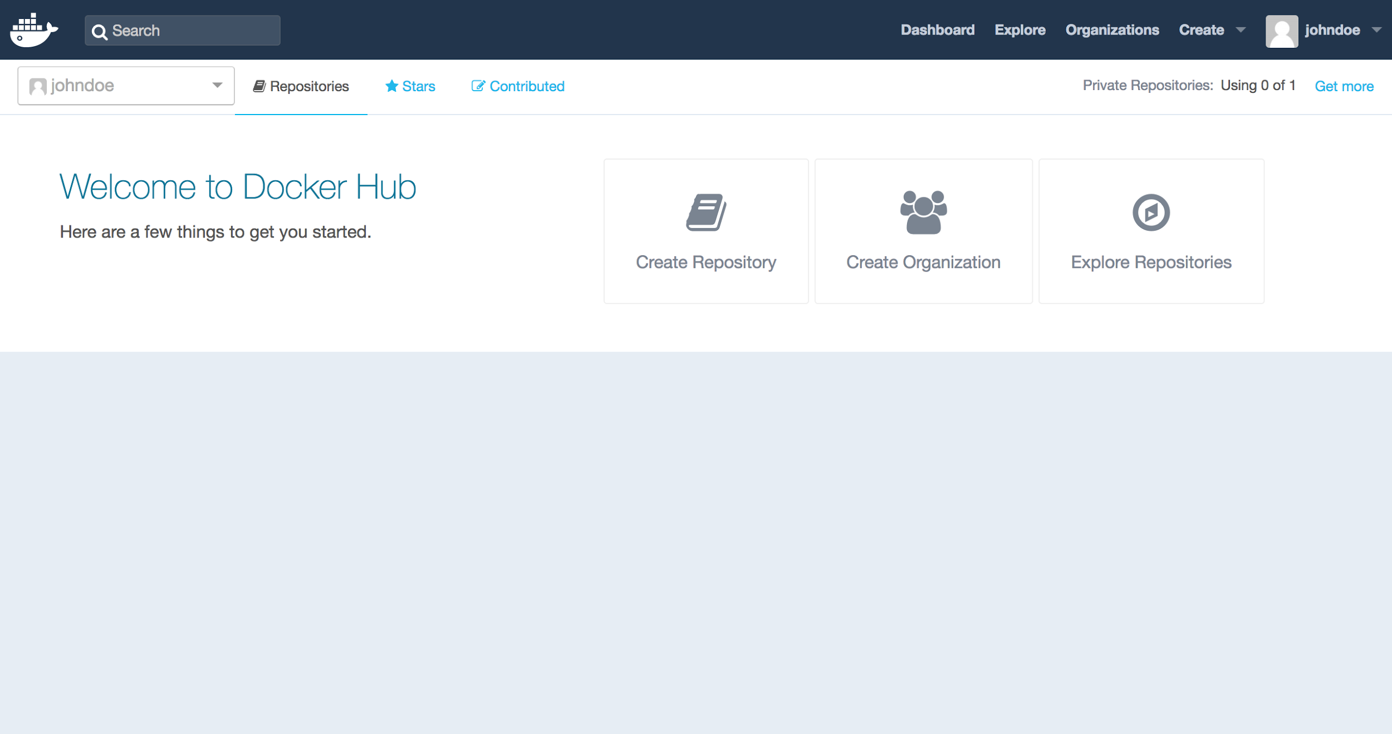
Docker Hub » Exercise

Slide 80
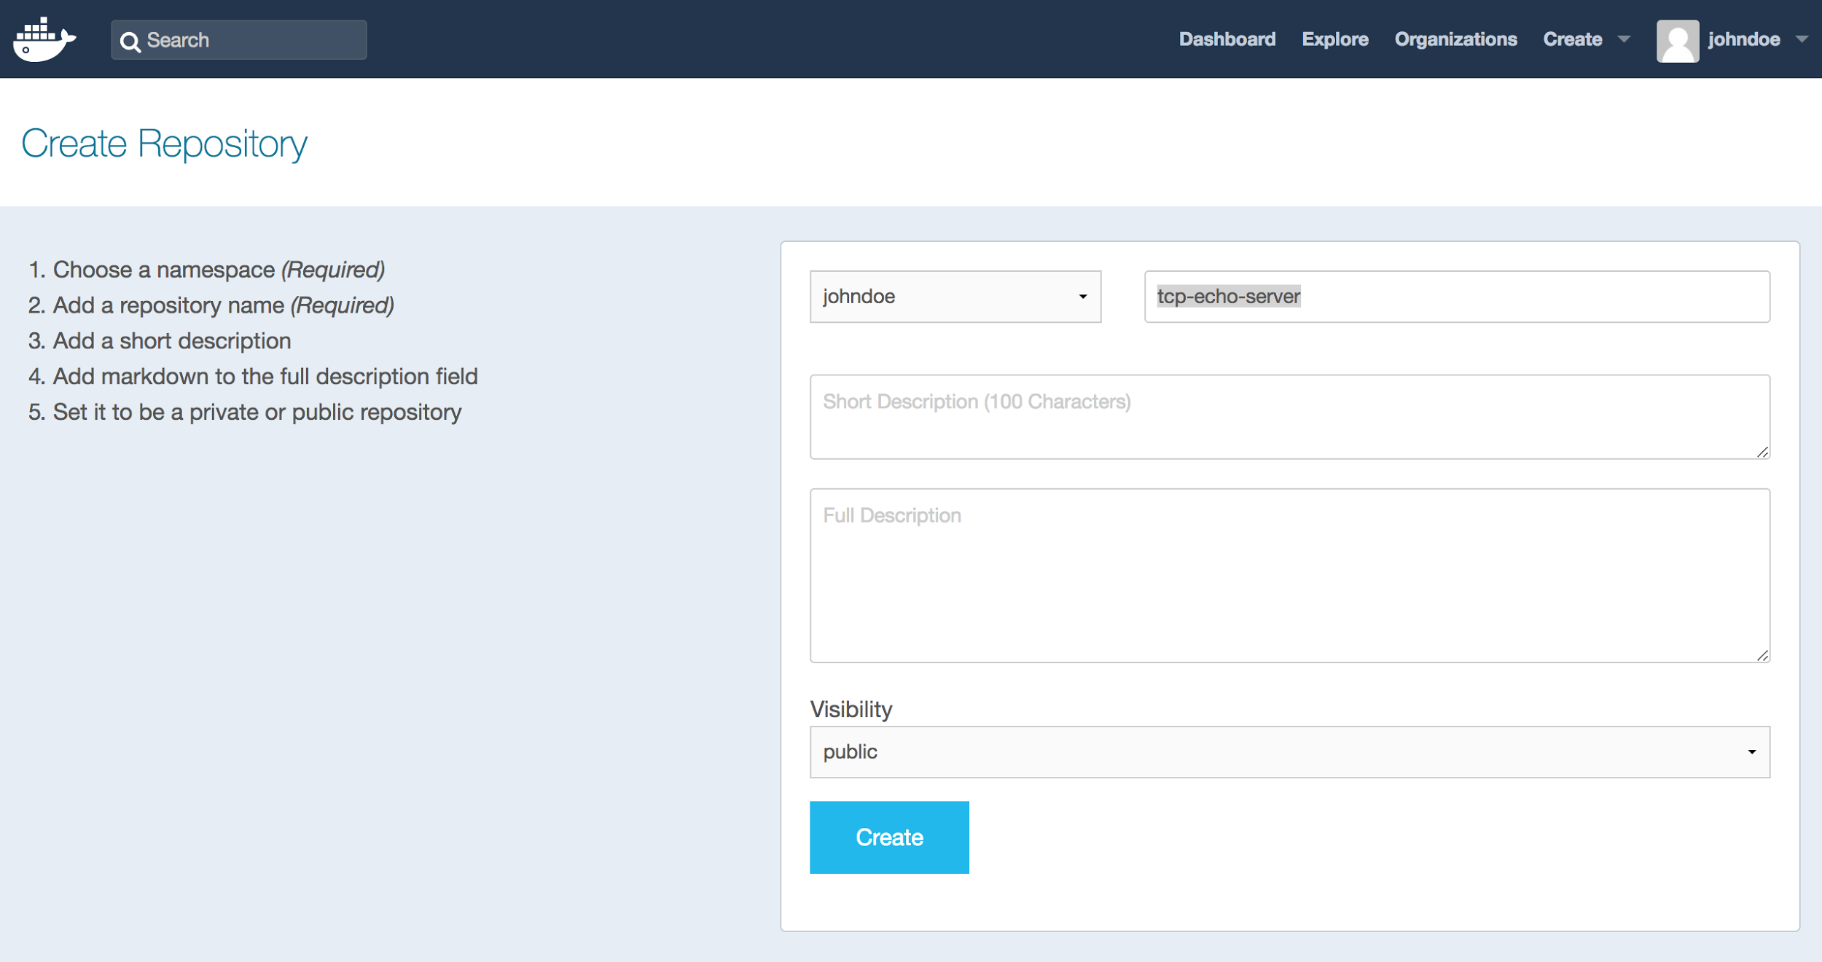
Docker Hub » Exercise

Slide 81
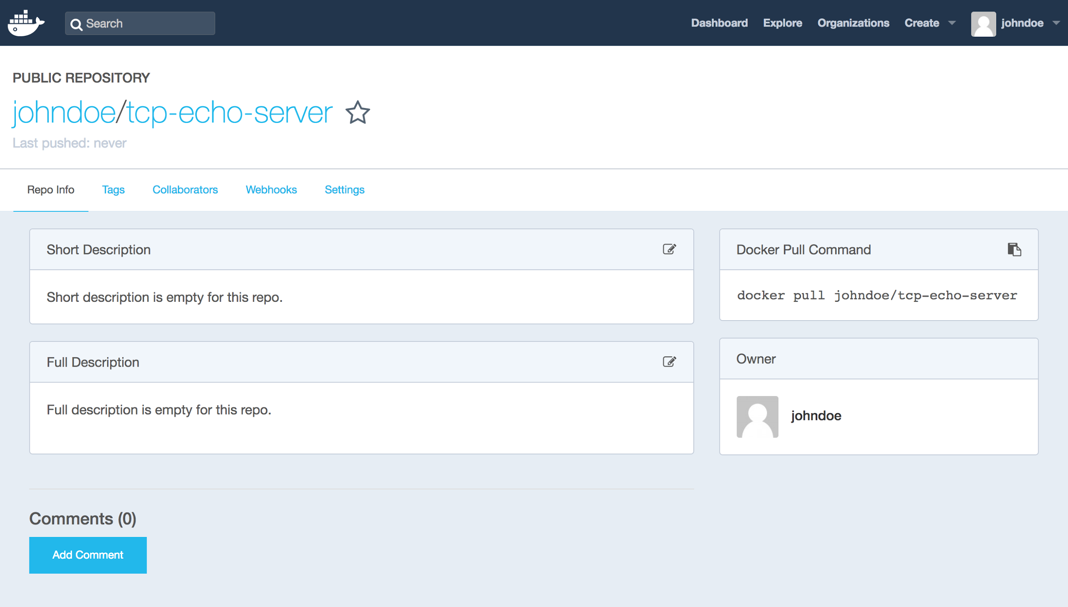
Docker Hub » Exercise

Slide 82
Docker Hub » Exercise
Now that we have a Docker ID and repository we need to login to Docker Hub using docker:
$ docker login
Login with your Docker ID to push and pull images from Docker Hub. If you don't have a Docker ID, head over to https://hub.docker.com to create one.
Username: johndoe
Password:
Login Succeeded

Slide 83
Docker Hub
There is one more thing we need to do before distributing our image — we have named it tcp-echo-server:0.2, but we can’t distribute it with such a name.
When pushing to remote registries, images usually have to be namespaced. For Docker Hub, that means naming them like <docker-id>/<repository>:<tag>.

Slide 84
Docker Hub » Exercise
$ docker tag tcp-echo-server:0.2-multistage johndoe/tcp-echo-server:0.2
$ docker push johndoe/tcp-echo-server:0.2
The push refers to a repository [docker.io/johndoe/tcp-echo-server]
98e0dcf00b5e: Pushed
5f70bf18a086: Pushed
9d566e6c07a8: Pushed
404361ced64e: Pushed
0.2: digest: sha256:de5b2b1... size: 1569

Slide 85
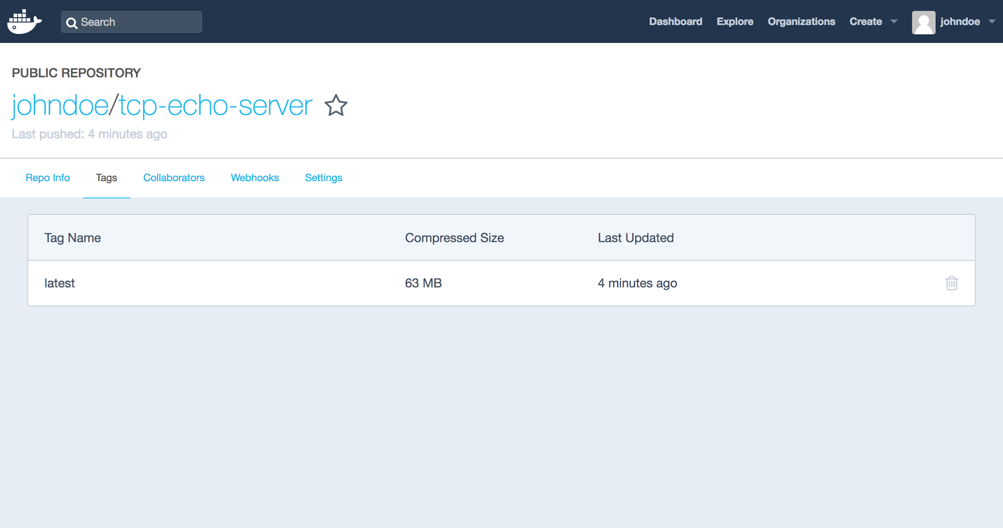
Docker Hub » Exercise

Slide 86
Questions?

Slide 87
Addendum

Slide 88
Dockerfile » ENTRYPOINT
The ENTRYPOINT instruction is used to specify an executable to run when launching the container.
ENTRYPOINT ["java"]
This instruction also supports providing parameters to the executable (although there are preferable forms to do that):
ENTRYPOINT ["java", "-jar", "/hello-world.jar"]

Slide 89
ENTRYPOINT vs CMD: The Short Story
The prefered way to declare what to run is
CMD ["executable", "param", "param", ..., "param"]
without an ENTRYPOINT instruction. This ensures that...
... executable is PID 1.
... executable adequately receives signals such as SIGTERM or SIGUSR1.
... parameters are easy to override when launching.

Slide 90
ENTRYPOINT vs CMD: The Long Story
Each instruction has two forms:
ENTRYPOINT ["executable", "param1", "param2"] # The 'exec' form.
ENTRYPOINT command param1 param2 # The 'shell' form.
CMD ["executable", "param1", "param2"] # The 'exec' form.
CMD command param1 param2 # The 'shell' form.
How do they interact? 🤔

Slide 91
ENTRYPOINT vs CMD: The Long Story
Here's what gets executed with each combination:
 | No ENTRYPOINT | ENTRYPOINT ["entry_exec, "entry_param_1"] | ENTRYPOINT entry_exec entry_param_1
No CMD | Error | /bin/sh -c entrypoint_exec entrypoint_param_1 | entry_exec entry_param_1
CMD ["cmd_exec", "cmd_param_1"] | cmd_exec cmd_param_1 | /bin/sh -c entrypoint_exec entrypoint_param_1 | entry_exec entry_param_1 cmd_exec cmd_param_1
CMD cmd_exec cmd_param_1 | /bin/sh -c cmd_exec cmd_param_1 | /bin/sh -c entrypoint_exec entrypoint_param_1 | entry_exec entry_param_1 /bin/sh -c cmd_exec cmd_param_1

Slide 92
ENTRYPOINT vs CMD: The Long Story
A few facts:
If shell format is used for ENTRYPOINT, CMD is ignored.
If exec format is used for ENTRYPOINT, CMD is appended to ENTRYPOINT.
If exec format is used for ENTRYPOINT and shell format is used for CMD, Docker adds /bin/sh -c to the middle of the command.
If exec format is used for both ENTRYPOINT and CMD, one might as well use CMD only, since it is easier to override.
Conclusion: Use CMD whenever possible. If we inherit an ENTRYPOINT from a base image, we should consider resetting it using ENTRYPOINT [].

